Slide 1
Modeling with UML #1

Slide 2

Activity Diagrams
An activity diagram is a special case of a state chart diagram
The states are activities (“functions”)
An activity diagram is useful to depict the workflow in a system
Notes:
There are two types of states:
Action state:
Cannot be decomposed any further
Happens “instantaneously” with respect to the level of abstraction used in the model
Activity state:
Can be decomposed further
The activity is modeled by another activity diagram

Slide 3
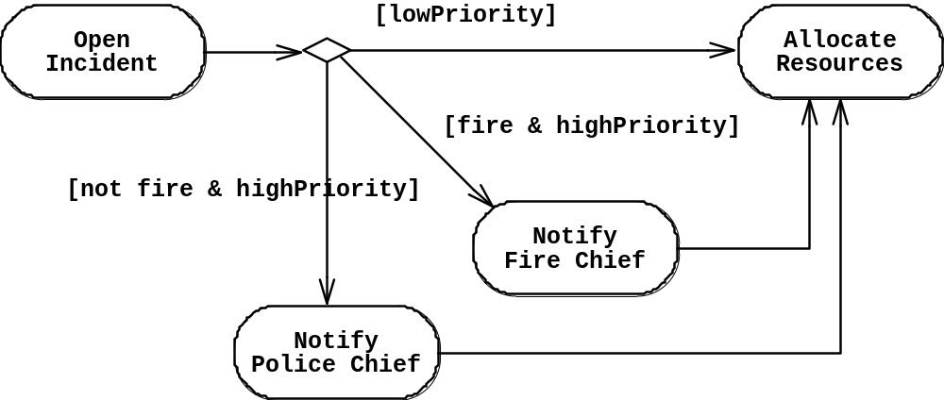
Activity Diagrams allow to model Decisions
Decision

Slide 4
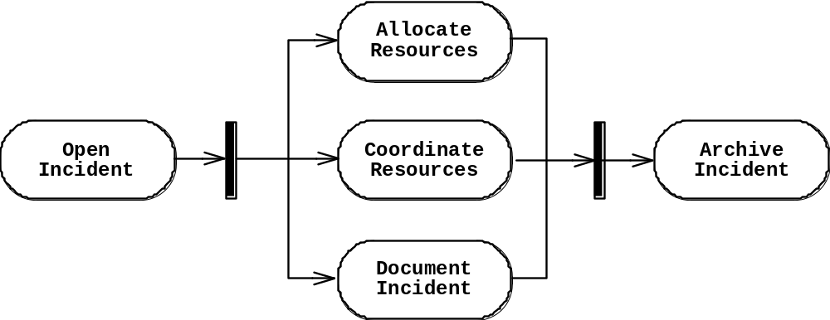
Activity Diagrams can model Concurrency
Synchronization of multiple activities
Splitting the flow of control into multiple threads
Splitting
Synchronization

Slide 5
Activity Diagrams: Grouping of Activities
Activities may be grouped into swimlanes to denote the object or subsystem that implements the activities.
Allocate
Dispatcher
Resources
Open
Coordinate
Archive
Incident
Resources
Incident
FieldOfficer
Document
Incident

Slide 6
Activity Diagram vs. Statechart Diagram
Statechart Diagram for Incident
Focus on the set of attributes of a single abstraction (object, system)
Event causes
state transition
Active
Inactive
Closed
Archived
Incident-
Handled
Incident-
Documented
Incident-
Archived
Activity Diagram for Incident
(Focus on dataflow in a system)
Completion of activity
causes state transition
Triggerless
transition
Notes:
Statechart Diagram for Incident (similar to Mealy Automaton)
Activity Diagram for Incident (similar to Moore Automaton)

Slide 7
UML Summary
UML provides a wide variety of notations for representing many aspects of software development
  Powerful, but complex
UML is a programming language
  Can be misused to generate unreadable models
  Can be misunderstood when using too many exotic features
We concentrated on a few notations:
  Functional model: Use case diagram
  Object model: class diagram
  Dynamic model: sequence diagrams, statechart and activity diagrams

